Slide 1
Data Analytics and Visualization for Digital Forensics
Module 3, Day 1
Part 1: Analysing data in digital forensics
Part 2: Visualising data in digital forensics
Dr.ir. Hans Henseler,
University of Applied Sciences Leiden (NL)
Master of Advanced Studies in Digital Forensics & Cyber Investigation
Bern University of Applied Sciences

Slide 2
Module 3: Data Analytics and Visualization
This module teaches the use of data analytics and visualization for digital forensics. Topics covered include:
Log analysis and correlation
Event reconstruction using timelines
Using Plaso to create super-timelines
Working with Big Data repositories
Correlation and relationship analysis
Statistical analysis
Advanced search techniques

Slide 3
Week overview
 | Day 1 | Day 2 | Day 3 | Day 4 | Day 5
Morning | Analysing data in digital forensics | Super time line with Plaso tools | ELK stack | Email Visualisation | Geolocation visualization
Afternoon | Visualising data in digital forensics | Big data with Elastic Search | ChatGPT as copilot *Project | Full-text search *Project | Student *Project presentations

Slide 4
Day 1 schedule
Day 1 | Forensic Analysis of Logfiles
08:30 9:00 | Introduction class
09:00 9:30 | Part 1: Analyzing data for Digital Forensics
10:30 | Exercise 1: Data analytics and visualization in Google Colab
12:00 | Lunch
13:00 | Part 2: Visualising data for Digital Forensics
14:15 | Exercise 2: Logfile extraction, analysis and visualization
16:20 | End of the day review

Slide 5
Day 1: Learning Goals
Quick introduction/refresher Python and Google Colaboratory
Working with Panda Dataframes
Pandas and statistical (analytical) operations
Cleaning data, filtering and sorting data
Time series data visualisation
Line Plots.
Histograms and Density Plots.
Box and Whisker Plots.
Heat Maps.
Lag Plots or Scatter Plots.
Autocorrelation Plots.

Slide 6

I am Hans Henseler
Current work:
Part-time professor Digital Forensics & E-Discovery at the University of Applied Sciences Leiden (HSL)
Senior scientist digital forensics at the Netherlands Forensic Institute (NFI)
Other current affiliations:
Chairman Board of Directors of Digital Forensics Research Conference (DFRWS)
Previous work:
NFI, TNO, ZyLAB, PWC, HvA, Fox-IT, Tracks Inspector, Magnet Forensics, board member NRGD
Education:
Computer Science Delft University of Technology
Ph.D. artificial neural networks Maastricht University.

Slide 7

And who are you?

Slide 8
Part 1: Analyzing data for Digital Forensics

Slide 9

Cross-Industry Standard Process for Data Mining
CRISP-DM:
Describes the typical phases of a project, the tasks involved with each phase, and an explanation of the relationships between these tasks.
Provides an overview of the data mining life cycle.
https://en.wikipedia.org/wiki/Cross-industry_standard_process_for_data_mining

Slide 10
What kind of data?
Numerical (numbers, e.g. int, float)
Categorical (discrete labeled values, e.g. red, green)
Events (date time)
Relationships (e.g. email)
Table
Relational database
Geolocations
Textual

Slide 11
Analyzing data
Average and Median
Maximum and minimum
Missing values
Type of data
Format of the data (e.g. date time format, time zone)
Outliers
Benford’s law
Distance measures
Centrality
Correlation
Structured Query Language (SQL)
Pivot table
Full-text search
Regular expressions
Similarity search
Dimension reduction

Slide 12
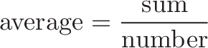
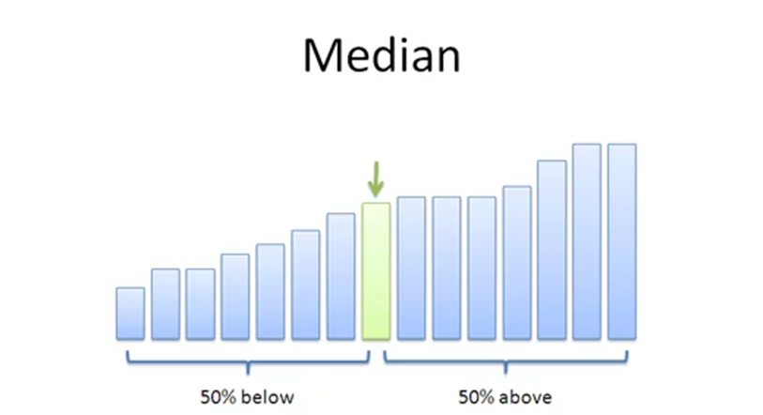
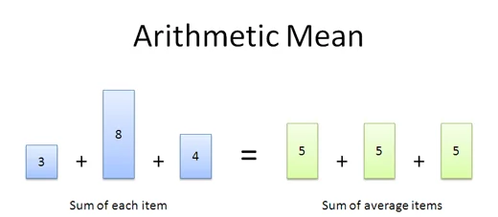
Average and Median

Slide 13
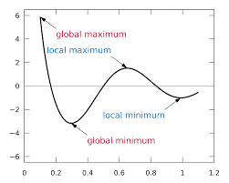
Maximum and Minimum

Slide 14
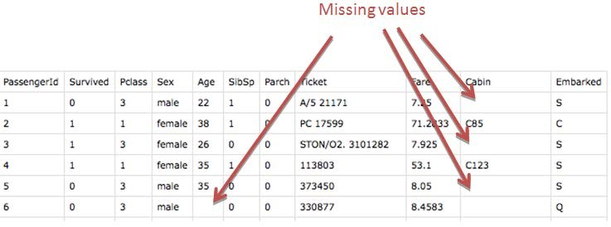
Missing values

Slide 15
Data types
Integer (int)
Floating Point (float)
Character (char)
String (str or text)
Boolean (bool)
Enumerated type (enum)
Array
Date(time)
… custom data types

Slide 16
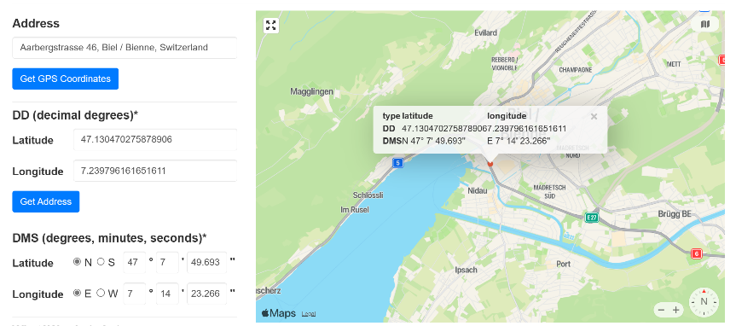
Data formats
Date(time) formats: yyymmdd, mm/dd/yy, hh:mm:ss, …
Geolocation:
DDD° MM' SS.S" | Degrees, Minutes and Seconds
DDD° MM.MMM' | Degrees and Decimal Minutes
DDD.DDDDD° | Decimal Degrees
https://www.gps-coordinates.net/gps-coordinates-converter

Slide 17
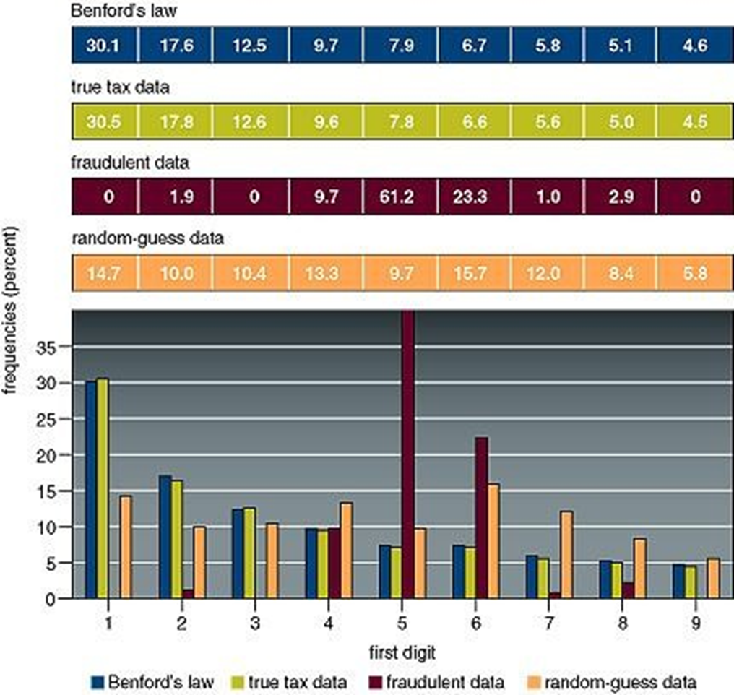
Benfords law
Befords law states that:
In a natural set of random numbers:
30% starts with a 1
17% starts with a 2
Etc
Examples of natural set:
Numbers in articles, river surface area, house numbers of random people, article prices, amounts in a taks return …
https://en.wikipedia.org/wiki/Benford%27s_law

Slide 18
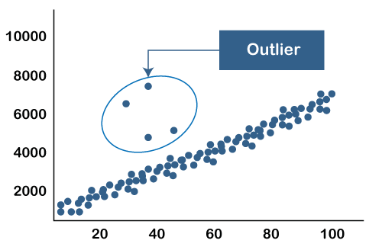
Outliers

Slide 19
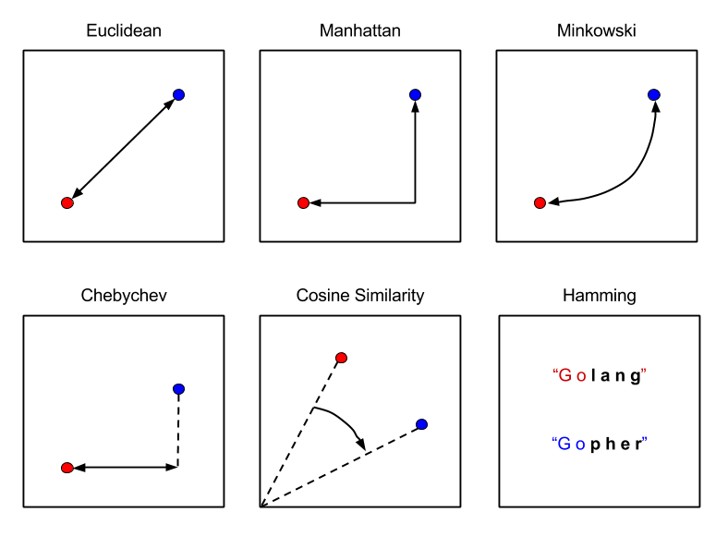
Distance measures

Slide 20
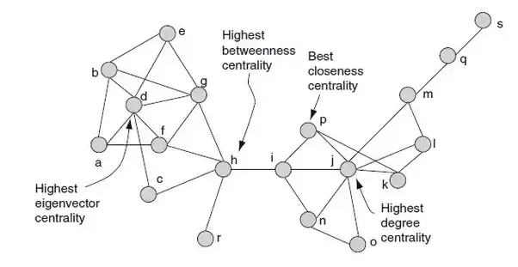
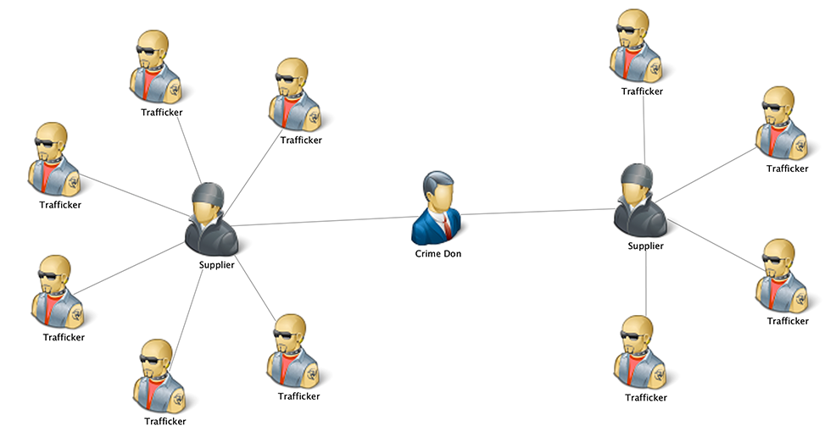
Centrality

Slide 21
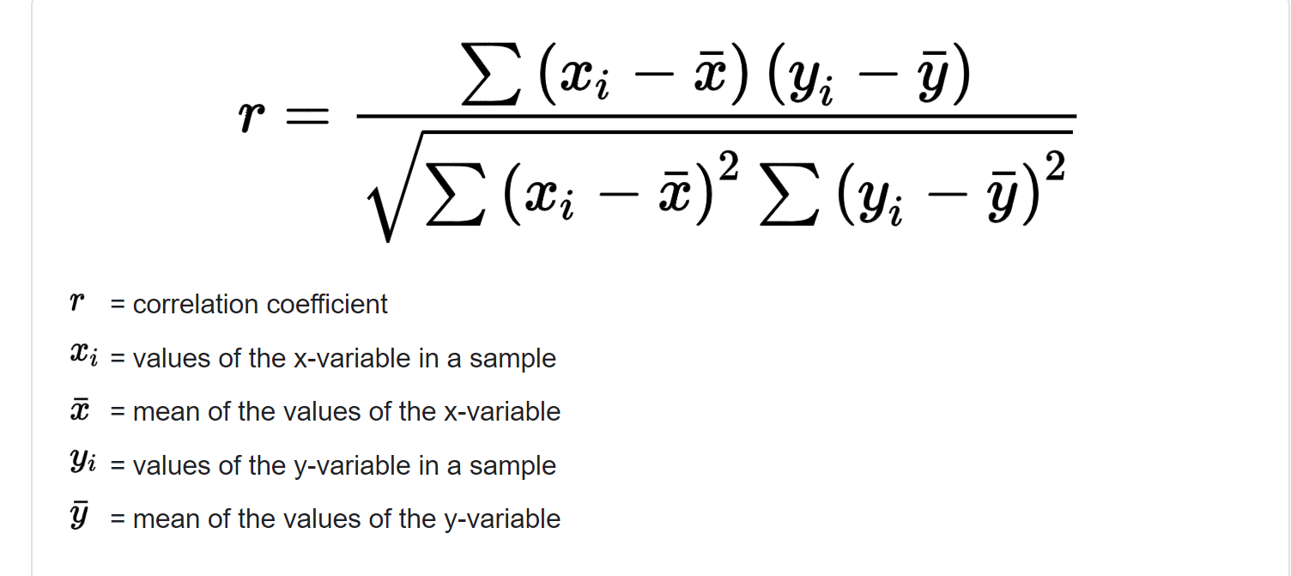
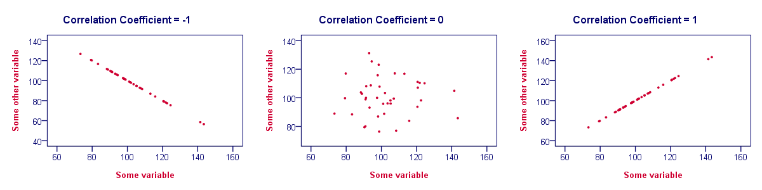
Correlation
The Pearson correlation coefficient is used to measure the strength of a linear association between two variables, where the value r = 1 means a perfect positive correlation and the value r = -1 means a perfect negataive correlation.

Slide 22
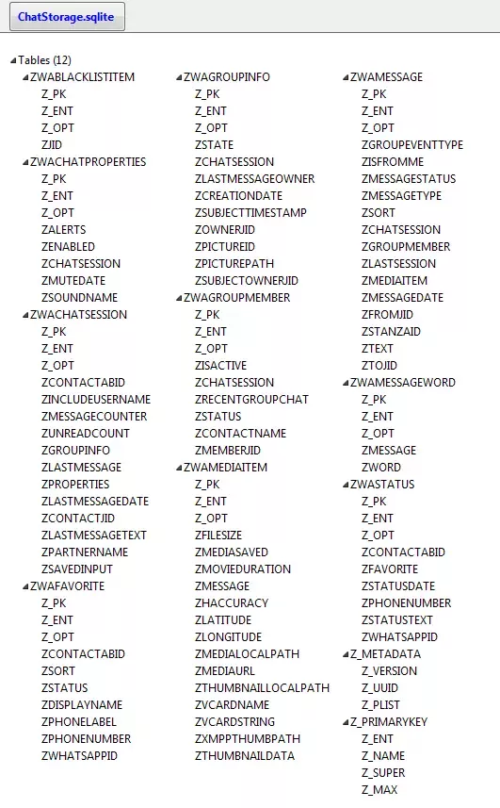
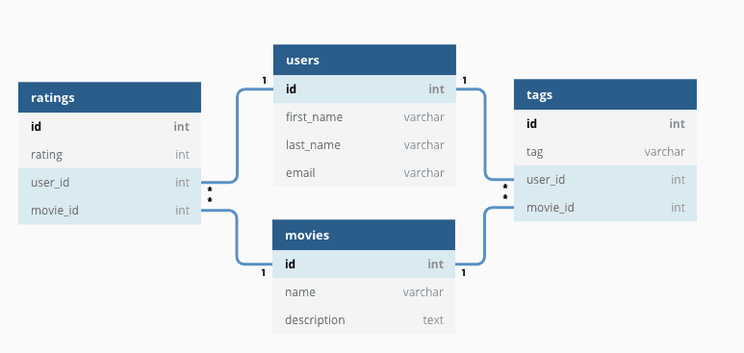
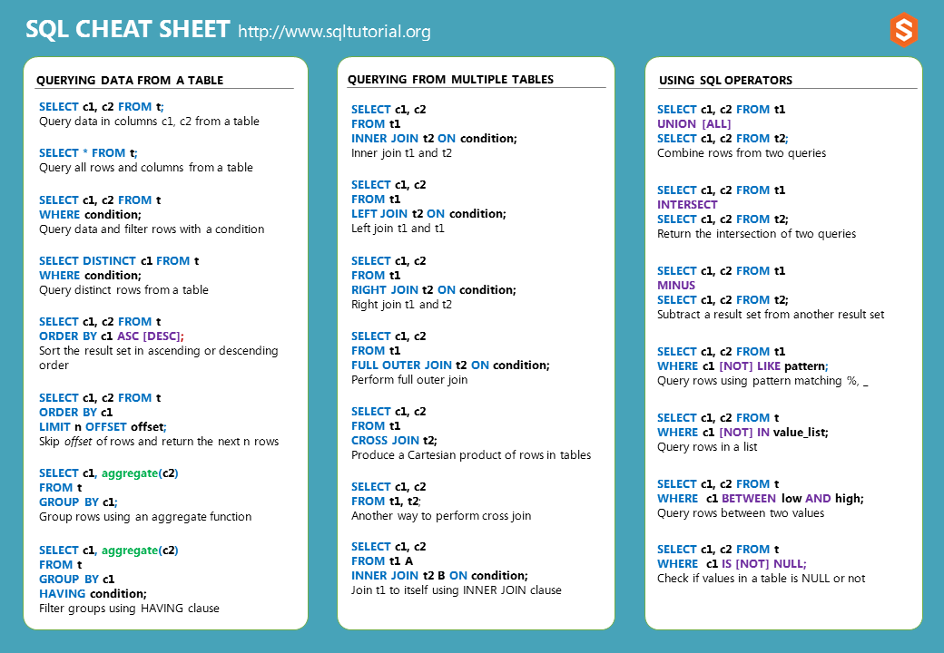
SQL: Structured Query Language
Whatsapp database

Slide 23
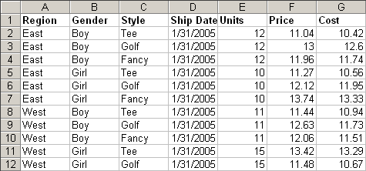
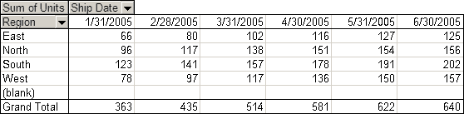
Pivot table

Slide 24
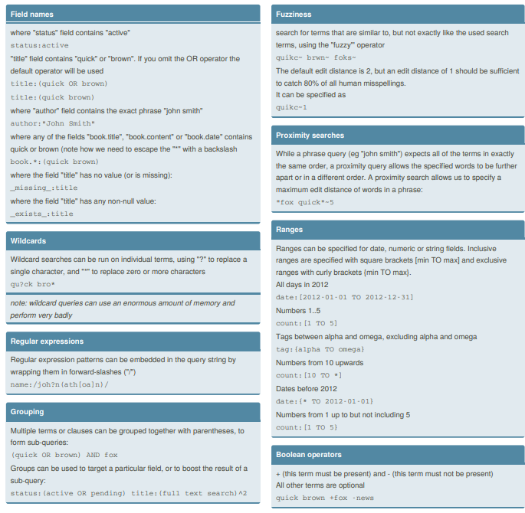
Full-text search
Elasticsearch query string syntax Cheat Sheet
Examples for using ElasticSearch/OpenSearch (lucene) query string syntax
https://cheatography.com/jelle/cheat-sheets/elasticsearch-query-string-syntax/

Slide 25
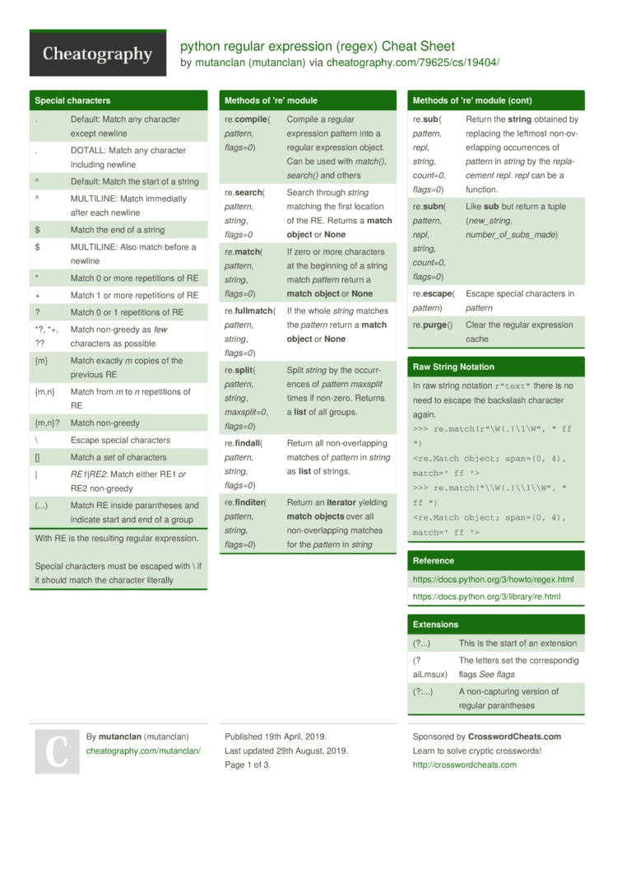
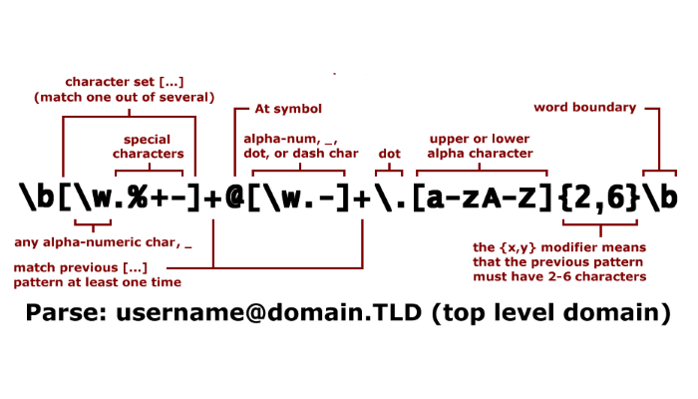
Regular expressions
https://cheatography.com/mutanclan/cheat-sheets/python-regular-expression-regex/

Slide 26
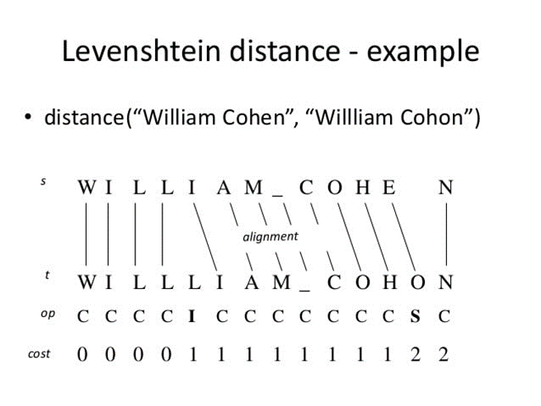
Similarity search: text
Levenshtein distance between two words is the minimum number of single-character edits (insertions, deletions or substitutions) required to change one word into the other.
https://en.wikipedia.org/wiki/Levenshtein_distance

Slide 27
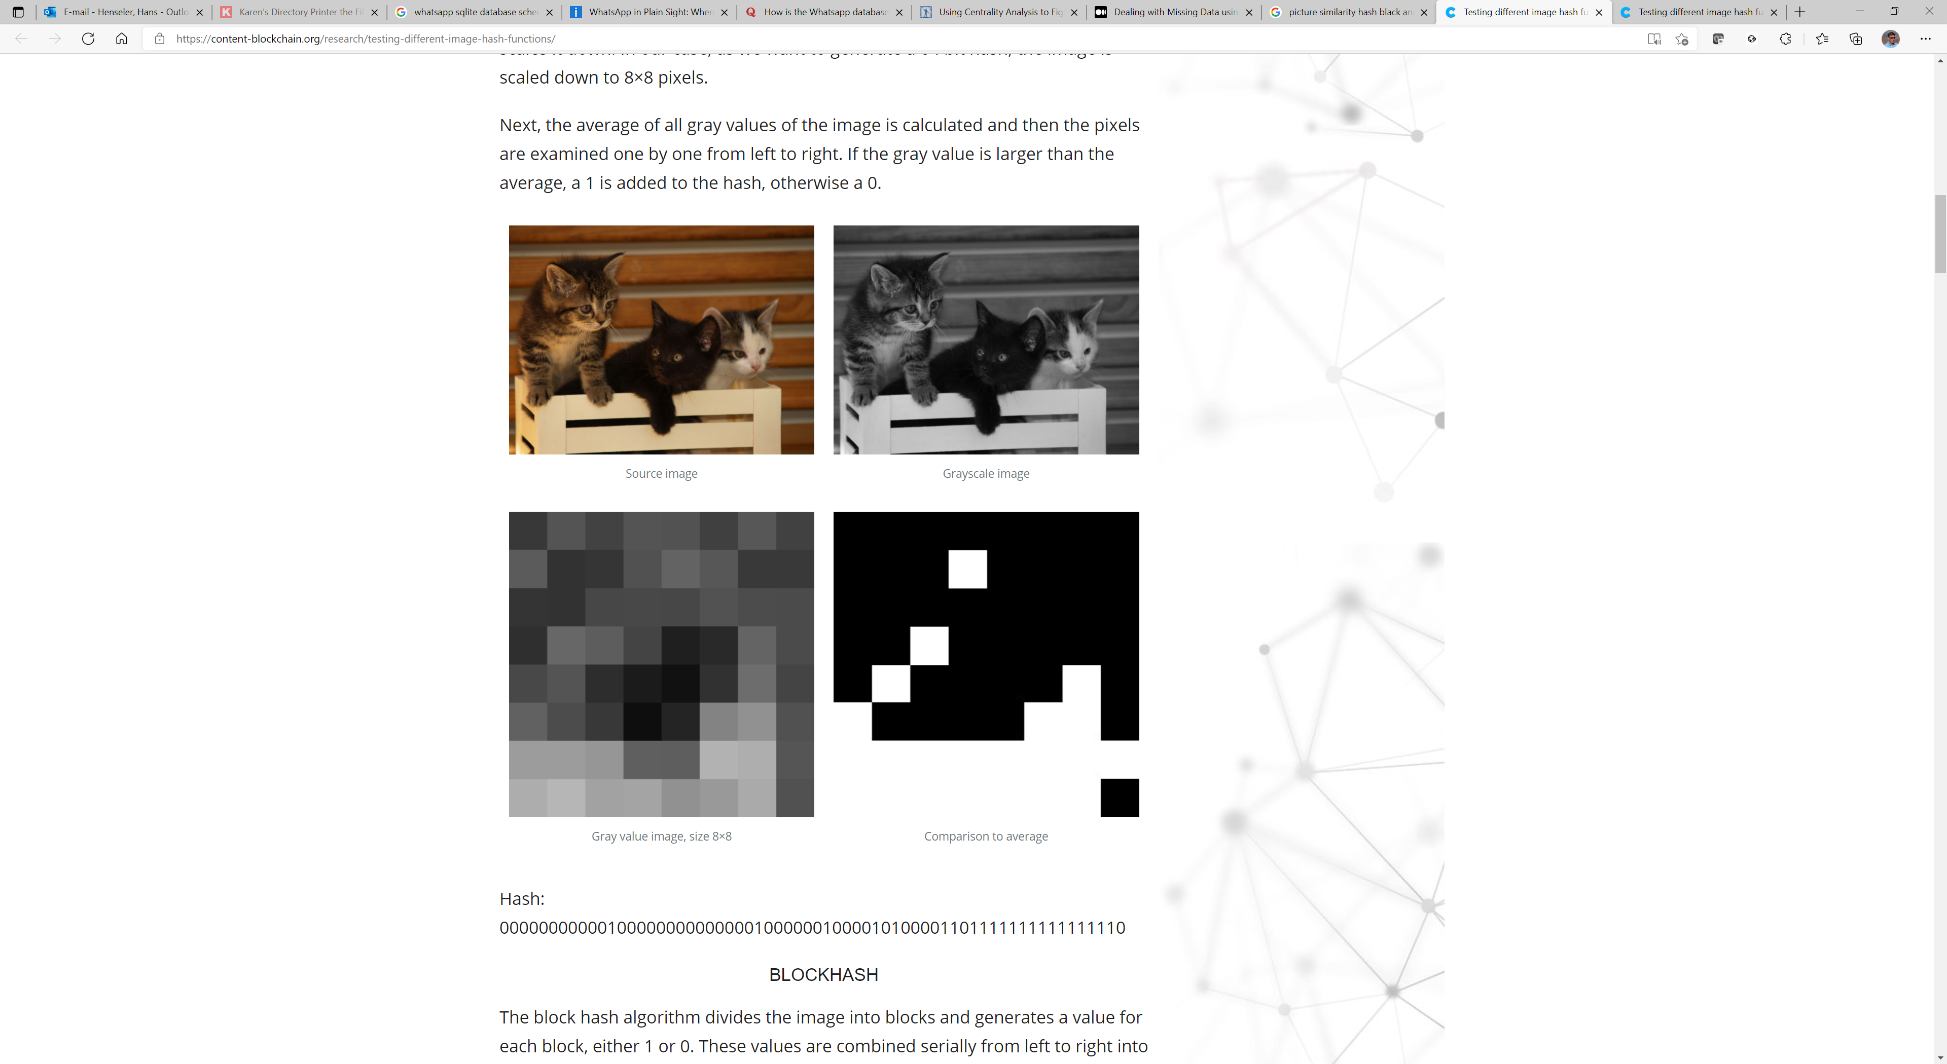
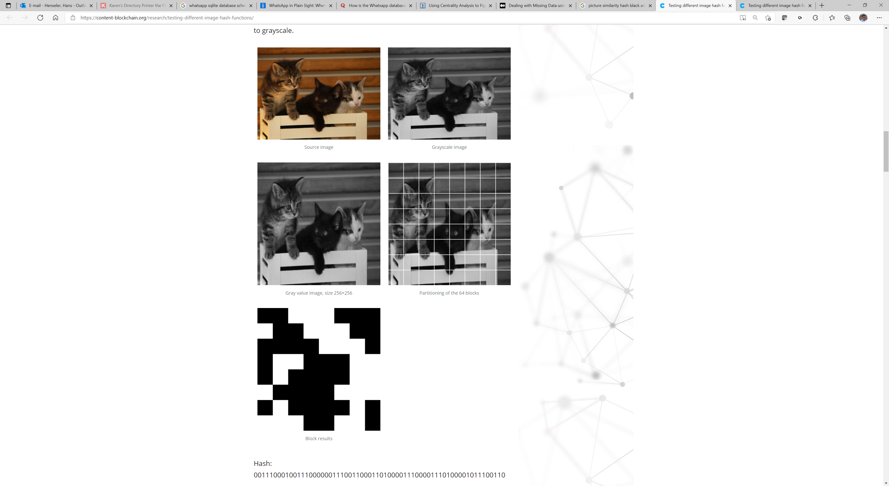
Similarity search: pictures
Average hash: first converts the input image to grayscale and then scales it down. In our case, as we want to generate a 64 bit hash, the image is scaled down to 8×8 pixels.
Block hash: divides the image into blocks and generates a value for each block, either 1 or 0. These values are combined serially from left to right into a hash. As we need a 64 bit hash, we divide the image into 64 blocks.

Slide 28
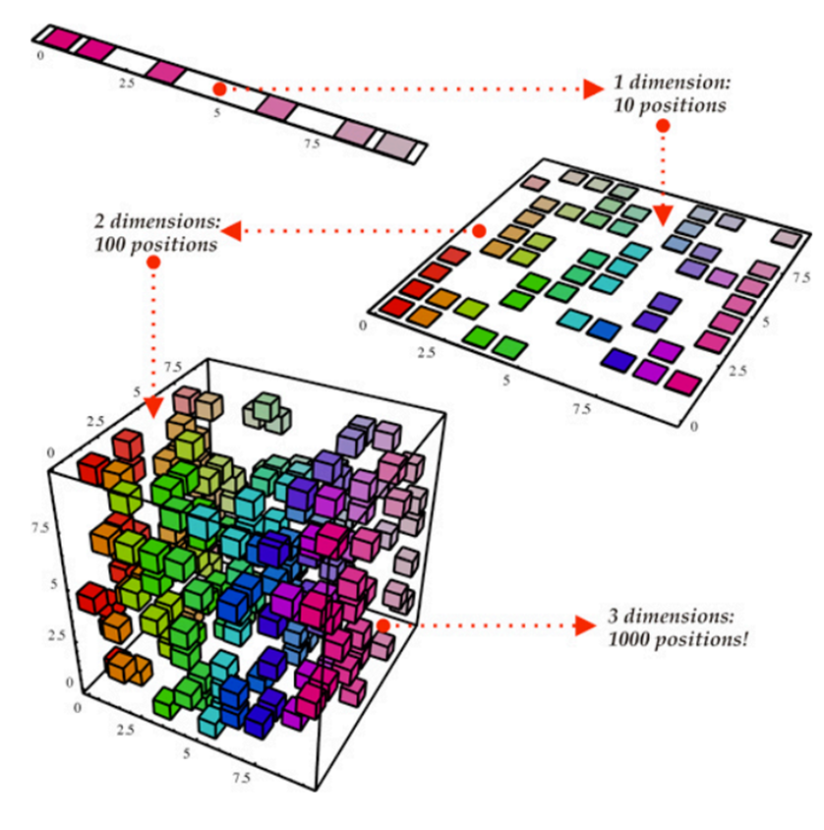
Dimension reduction
Dimensionality reduction means projecting data to a lower-dimensional space, which makes it easier for analyzing and visualizing data.
However, the reduction of dimension requires a trade-off between accuracy (high dimensions) and interpretability (low dimensions).

Slide 29
Dimension reduction: PCA and tSNE
PCA (Principal Component Analysis) is famous because it is simple, fast, easy to use, and retains the overall variance of the dataset. PCA performs linear dimension reduction. https://en.wikipedia.org/wiki/Principal_component_analysis
t-SNE (T-distributed Stochastic Neighbor Embedding) is a nonlinear dimensionality reduction technique that is well suited for embedding high dimension data into lower dimensional data (2D or 3D) for data visualization. https://en.wikipedia.org/wiki/T-distributed_stochastic_neighbor_embedding

Slide 30
10:00-10:15

Slide 31
Exercise 1: Data analytics in Google Colab

Slide 32
Exercise timings
15 minutes per exercise (app) and 5 minutes recap
Exercise 1 recap 10:35
Exercise 2 recap 10:55
Exercise 3 recap 11:15
Exercise 4 recap 11:35
Exercise 5 recap 11:55

Slide 33
12:00-13:00

Slide 34
Part 2: Visualising data for Digital Forensics

Slide 35
Visualizing data
Timeline
Treemap
Heatmap
Graph visualisation
Pie, bar and line chart
Scatterplot
Geomap
Correlation matrix
Calendar view
Parallel coordinates plot
Sunburst
Streamgraph
Circle packing
Word cloud
Boxplot
Bubble chart

Slide 36
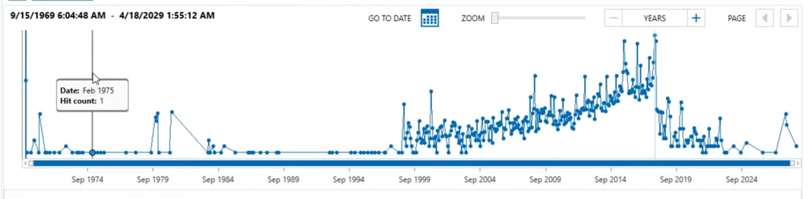
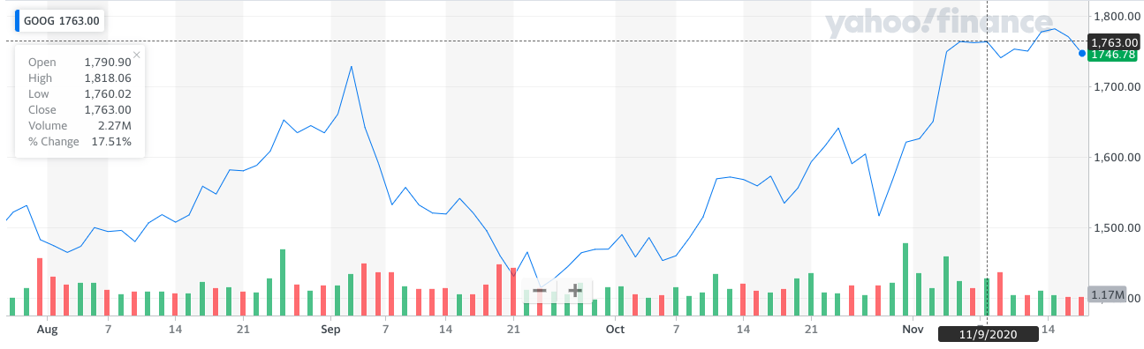
Timeline

Slide 37
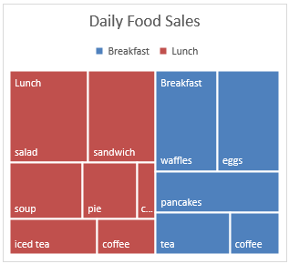
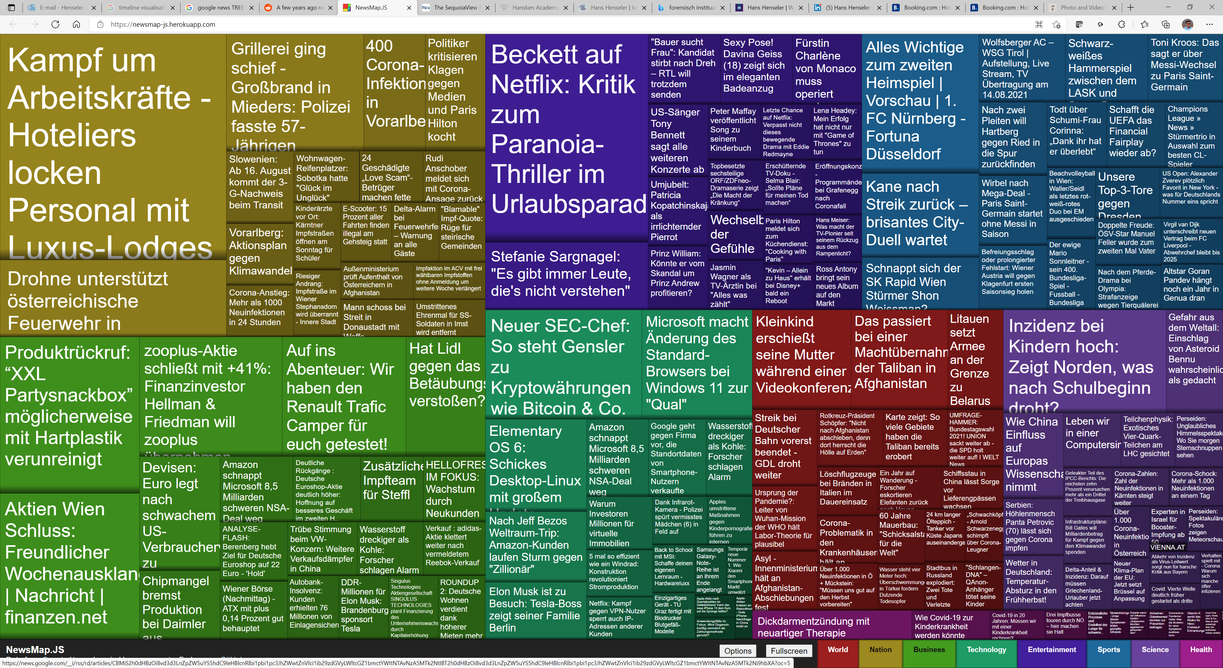
Treemap

Slide 38
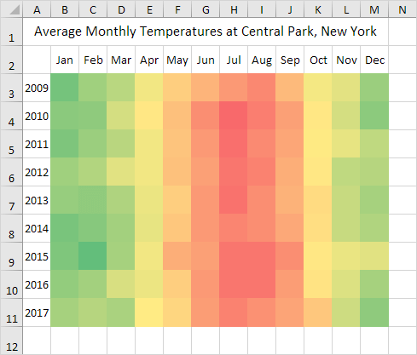
Heatmap

Slide 39
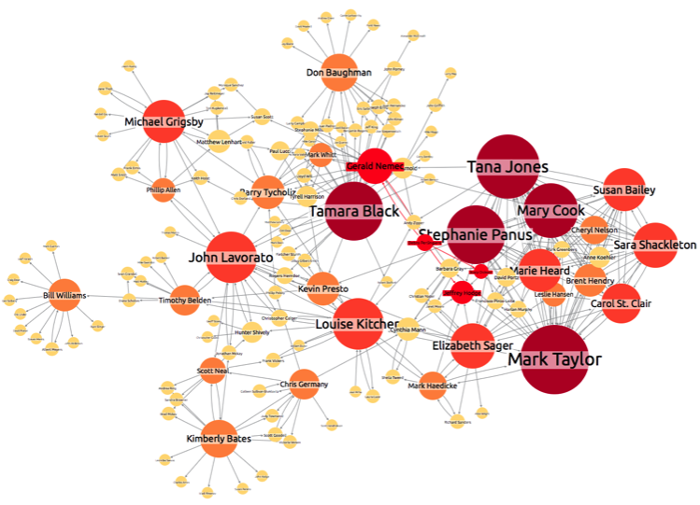
Graph visualisation

Slide 40
Bar chart

Slide 41
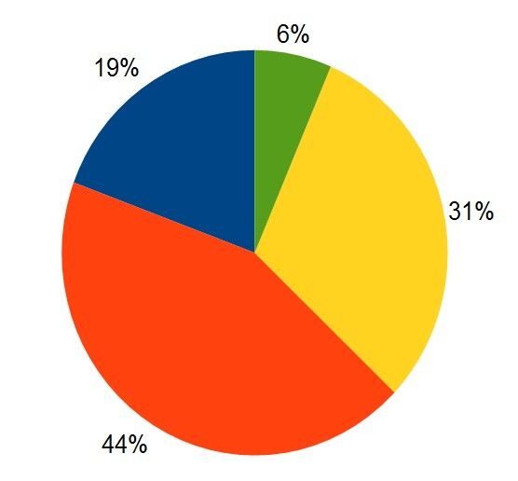
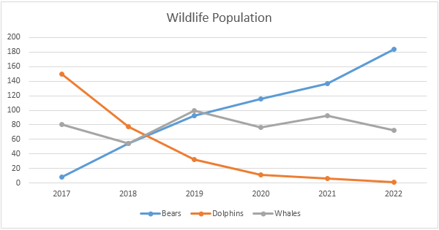
Pie and line chart

Slide 42
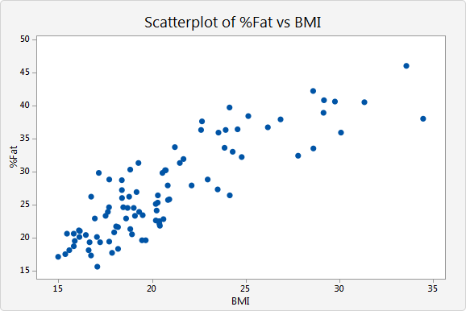
Scatterplot

Slide 43
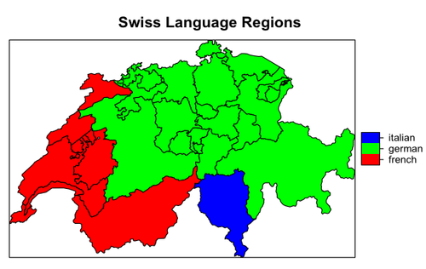
Geomap

Slide 44
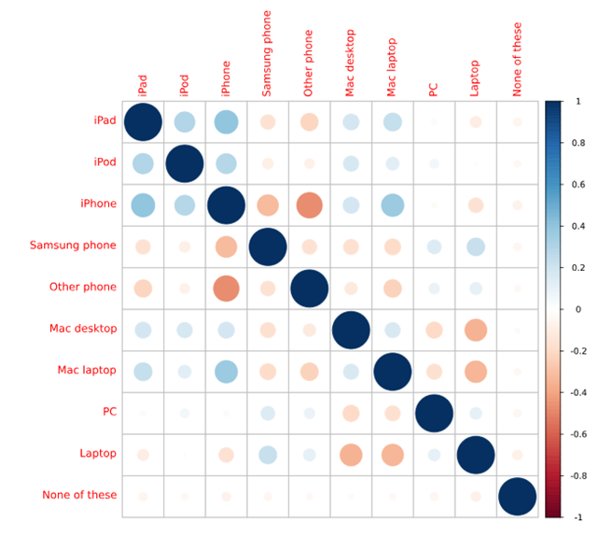
Correlation matrix
Data from a technology survey in which respondents were asked which devices they owned.
We want to examine if there is a relationship between any of the devices owned by running a correlation matrix for the device ownership variables.

Slide 45
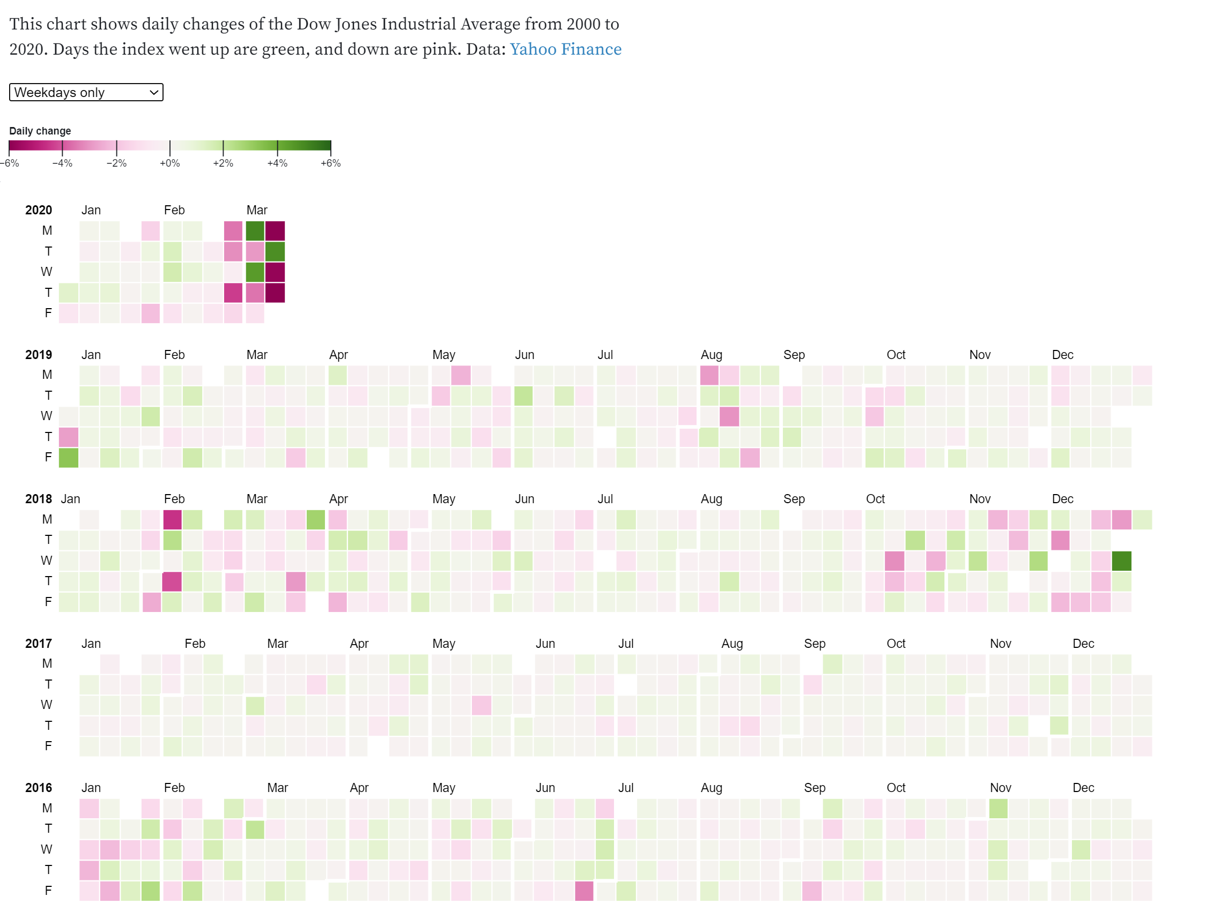
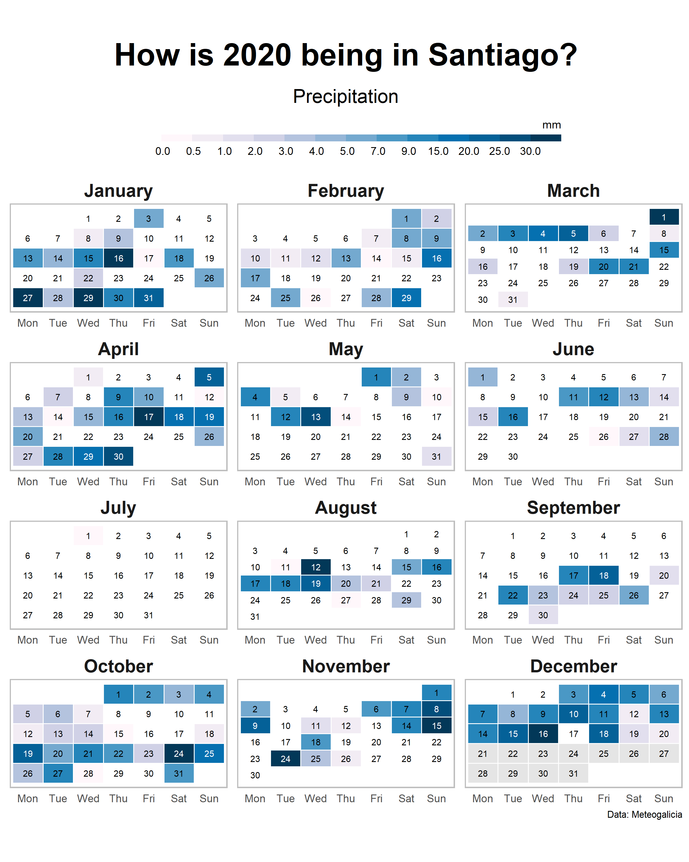
Calendar view

Slide 46
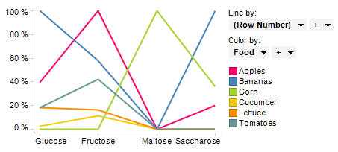
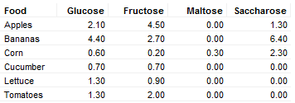
Parallel coordinates plot

Slide 47
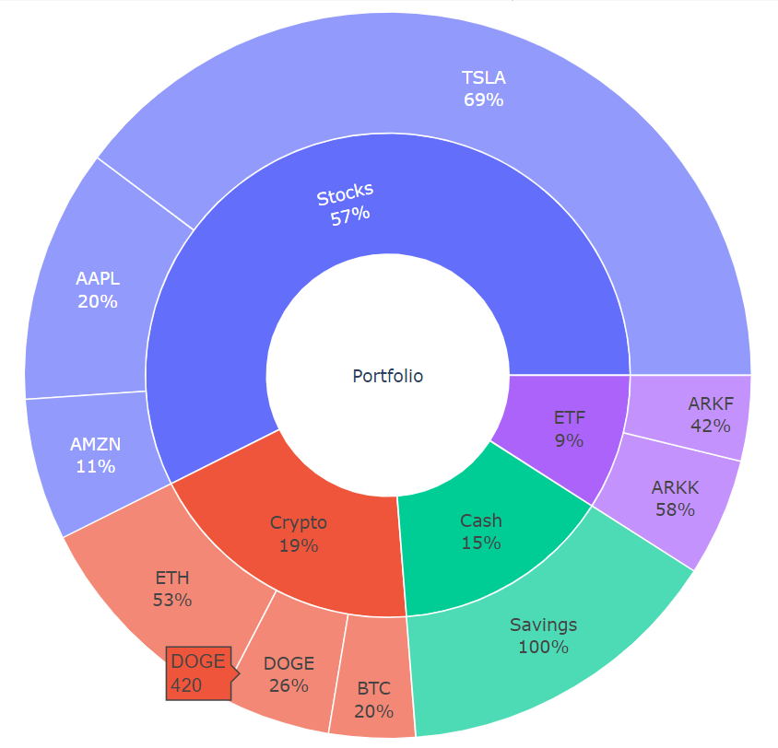
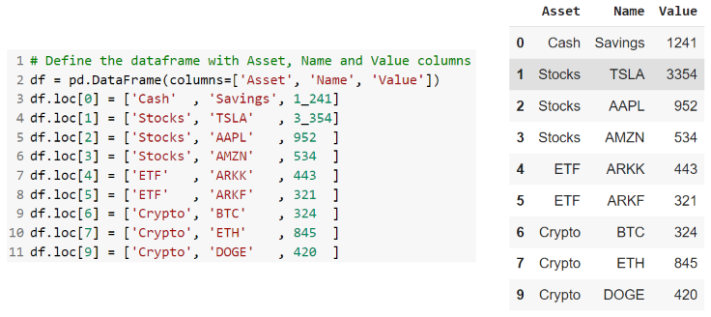
Sunburst
A Sunburst Diagram is a representation of hierarchical categories. It looks like a pie chart, the difference is just that in this the hierarchical sub-categories are stacked upon each other. Every level of the hierarchy represents a ring.

Slide 48
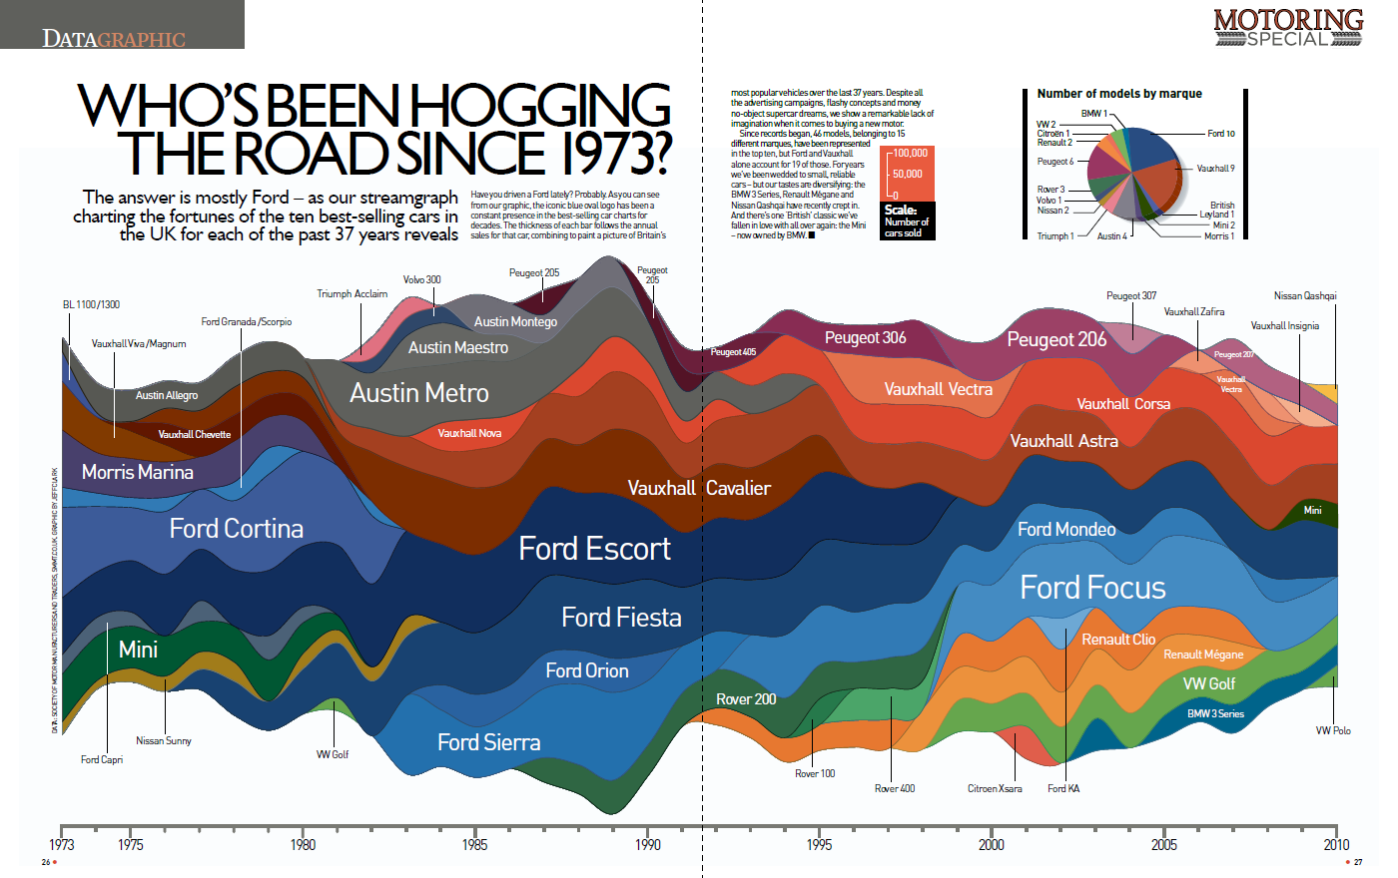
Streamgraph

Slide 49
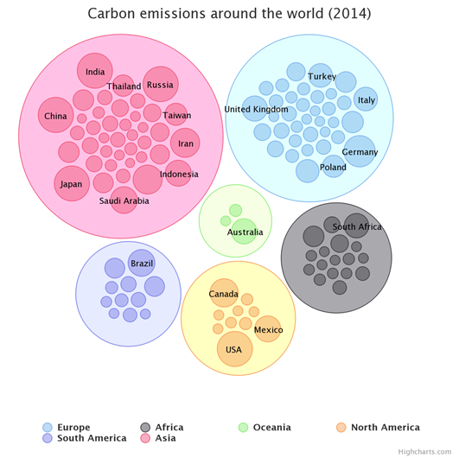
Circle packing
Circle Packing is a visualization to show hierarchical data using nested circles.
It is just like a treemap but uses circles instead of rectangles.
Every circle represents a category, and their sub-categories are within it.
The greater the size of the circle, the greater will be the value of that category and vice versa.

Slide 50
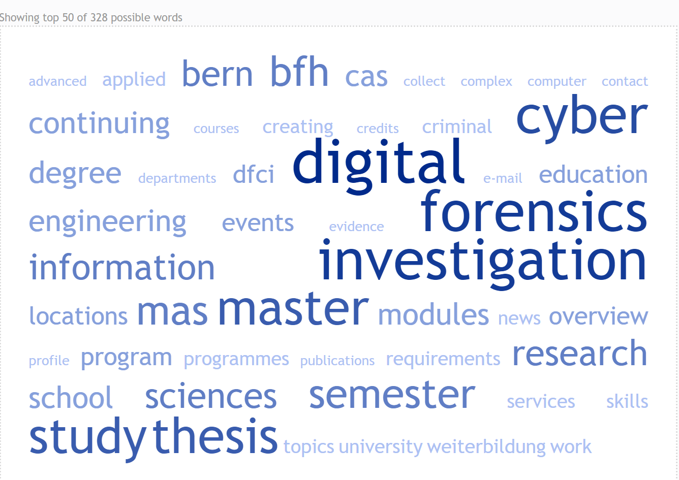
Wordcloud
Word clouds (also known as text clouds or tag clouds) work in a simple way: the more a specific word appears in a source of textual data (such as a speech, blog post, or database), the bigger and bolder it appears in the word cloud.
Try online: https://tagcrowd.com/

Slide 51
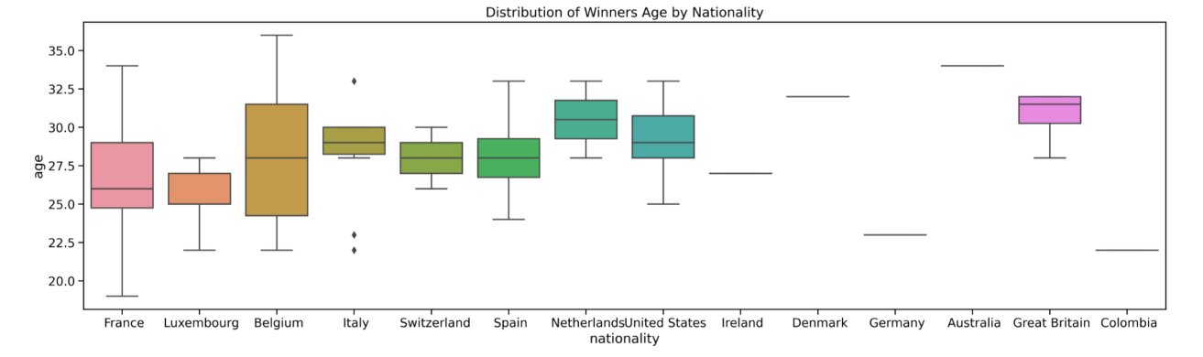
Boxplot

Slide 52
Bubble chart
Number of Products | Sales | Percentage of Market Share
5 | $5,500 | 3%
14 | $12,200 | 12%
20 | $60,000 | 33%
18 | $24,400 | 10%
22 | $32,000 | 42%

Slide 53
14:00-14:15

Slide 54
Exercise 2: Logfile extraction, analysis and visualization

Slide 55
Exercise timing
15 minutes per exercise and 5 minutes recap
14:35 Recap exercise 1
14:55 Recap exercise 2
15:15 Recap exercise 3
15:35 Recap exercise 4
15:55 Recap exercise 5
16:15 Recap exercise 6

Slide 58
Contact information
Dr.ir. Hans Henseler
henseler.h@hsleiden.nl

